Slide 1

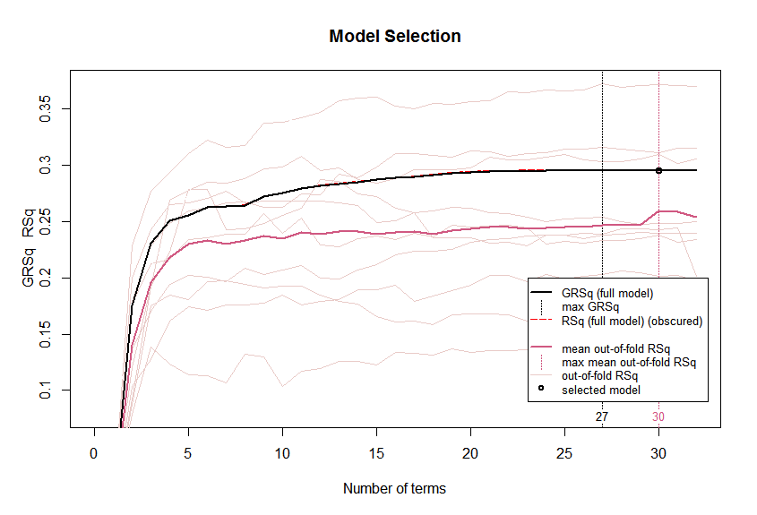
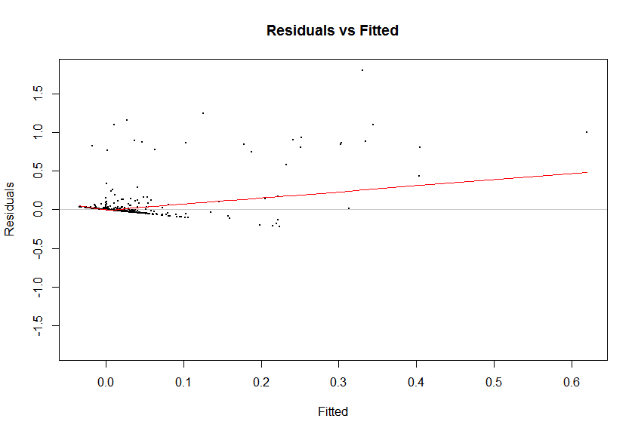

Precipitation Prediction Method: Regression Spline Datasource: https://www.ncdc.noaa.gov/cdo-web/datasets
FEATURES
Regression splines are a flexible class of basis functions that extends over piecewise constant regression and polynomial regression.
Selected EARTH package to implement Multivariate Adaptive Regression Spline (MARS) and used cubic spline with hinge base non-parametric approach.
Stratified Cross-validation method for accurate estimates and degree 2 correlation for including interaction terms.
Minimized overfitting by cross validation method rather than forward and backward selection methods.
Performance is calculated by CVR²,CVRSS,gR², mean absolute accuracy percentage. With huge data and complex model, calculated accuracy is relatively high.
Cross validation scheme to give appropriate test accuracy.
RESULTS
Generalized R² approximately equal to test R², out of fold cross validation R² is close to actual test R², max gR², max CVR² and selected model are close to each other.
Input data:
Predictors = Precipitation, Visibility, Dry bulb Temp, Wet bulb Temp, Humidity, Wind speed, Station Pressure, Sea-level Pressure, Altimeter setting, Wind Direction etc.,
No. of observations = ~1,00,000
gR²=0.294 ; CVR²=0.259 ; Standard Deviation=0.0614 ;
Mean absolute prediction accuracy = 86.33%
Residual Sum of Squares = 71.92

